Slide 1
Flipped Classroom
& PBL:
Theory and Practice
Bill Huitt
@whuitt
Katie Vernon
@KVernonBHS
Back Channel:
https://todaysmeet.com/FlippedPBLWorkshop

Slide 2
Part 5 PBL Supporting Learning Theories

Slide 3
Project/Problem Based Learning (PBL)
Problem vs Project:
Notes:
Application, evaluation, synthesis of concepts
Student voice and choice
Students set goals and learn how to break down big projects
Allows for and encourages interdisciplinary studies

Slide 4
Project/Problem Based Learning (PBL)
Problem vs Project:
Problem = use case studies, solve problems
Notes:
Application, evaluation, synthesis of concepts
Student voice and choice
Students set goals and learn how to break down big projects
Allows for and encourages interdisciplinary studies

Slide 5
Project/Problem Based Learning (PBL)
Problem vs Project:
Problem = use case studies, solve problems
Project = “maker” movement, create something new/different
Notes:
Application, evaluation, synthesis of concepts
Student voice and choice
Students set goals and learn how to break down big projects
Allows for and encourages interdisciplinary studies

Slide 6
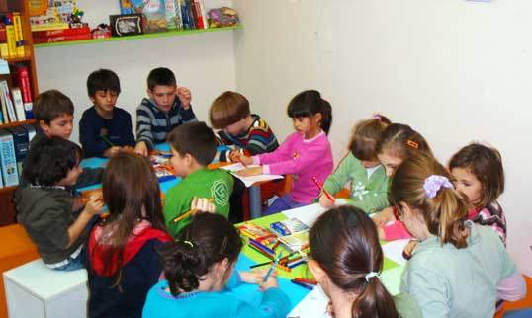
Constructivism
Social
Notes:
Social Constructivism
Vygotsky, Dewey
Importance of social interaction and language
Zone of Proximal Development
Scaffolding -- systematically remove reminders and aides
Cognitive Constructivism
Piaget, Bruner
Equilibrium
Create disequilibrium through exploration and inquiry
Create learning environments appropriate to learner’s cognitive stage and subject matter
Pre-operational (sensory/tactile, playful)
Concrete operational (sensory/tactile, rules and guidelines)
Formal operational (abstract concepts)

Slide 7
Constructivism
Cognitive
Social
Notes:
Social Constructivism
Vygotsky, Dewey
Importance of social interaction and language
Zone of Proximal Development
Scaffolding -- systematically remove reminders and aides
Cognitive Constructivism
Piaget, Bruner
Equilibrium
Create disequilibrium through exploration and inquiry
Create learning environments appropriate to learner’s cognitive stage and subject matter
Pre-operational (sensory/tactile, playful)
Concrete operational (sensory/tactile, rules and guidelines)
Formal operational (abstract concepts)

Slide 8
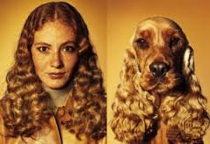
Humanism
Not simply animals with higher functioning mental processing
Notes:
Rogers, Maslow
Human beings are not simply animals with higher functioning mental processing
Emotions are as important as thoughts
Importance of the arts
Promote self-direction, personal responsibility, curiosity, creativity, and independence
Instructional techniques
Respond to learner feelings
Use learner ideas in ongoing instructional interactions
Engage in discussions with students
Use familiar language when engaged with learners
Tailor content to individual’s frame of reference
Smile

Slide 9
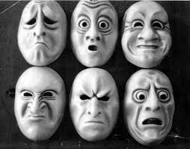
Humanism
Not simply animals with higher functioning mental processing
Emotions are as important as thoughts
Notes:
Rogers, Maslow
Human beings are not simply animals with higher functioning mental processing
Emotions are as important as thoughts
Importance of the arts
Promote self-direction, personal responsibility, curiosity, creativity, and independence
Instructional techniques
Respond to learner feelings
Use learner ideas in ongoing instructional interactions
Engage in discussions with students
Use familiar language when engaged with learners
Tailor content to individual’s frame of reference
Smile

Slide 10
Humanism
Not simply animals with higher functioning mental processing
Emotions are as important as thoughts
Importance of the arts
Notes:
Rogers, Maslow
Human beings are not simply animals with higher functioning mental processing
Emotions are as important as thoughts
Importance of the arts
Promote self-direction, personal responsibility, curiosity, creativity, and independence
Instructional techniques
Respond to learner feelings
Use learner ideas in ongoing instructional interactions
Engage in discussions with students
Use familiar language when engaged with learners
Tailor content to individual’s frame of reference
Smile

Slide 11
Humanism
Not simply animals with higher functioning mental processing
Emotions are as important as thoughts
Importance of the arts
Promote self-direction, personal responsibility, curiosity, creativity, and independence
Notes:
Rogers, Maslow
Human beings are not simply animals with higher functioning mental processing
Emotions are as important as thoughts
Importance of the arts
Promote self-direction, personal responsibility, curiosity, creativity, and independence
Instructional techniques
Respond to learner feelings
Use learner ideas in ongoing instructional interactions
Engage in discussions with students
Use familiar language when engaged with learners
Tailor content to individual’s frame of reference
Smile

Slide 12
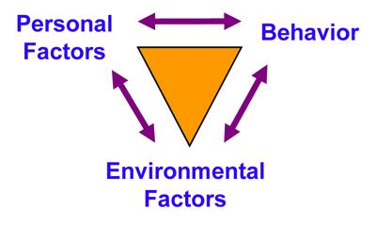
Social Cognition
Notes:
Bandura
Reciprocal determinism
Environment
Personal characteristics
Behavior
Focus on self-efficacy and self-regulation
Self-efficacy
Mastery experiences
Social Persuasion
Modeling
Self-regulation
Goals
Action plan
Implement and evaluate
Reflect
Modify and repeat

Slide 13
Social Cognition
Self-efficacy
Notes:
Bandura
Reciprocal determinism
Environment
Personal characteristics
Behavior
Focus on self-efficacy and self-regulation
Self-efficacy
Mastery experiences
Social Persuasion
Modeling
Self-regulation
Goals
Action plan
Implement and evaluate
Reflect
Modify and repeat

Slide 14
Social Cognition
Self-efficacy
Self-regulation
Notes:
Bandura
Reciprocal determinism
Environment
Personal characteristics
Behavior
Focus on self-efficacy and self-regulation
Self-efficacy
Mastery experiences
Social Persuasion
Modeling
Self-regulation
Goals
Action plan
Implement and evaluate
Reflect
Modify and repeat

Slide 15
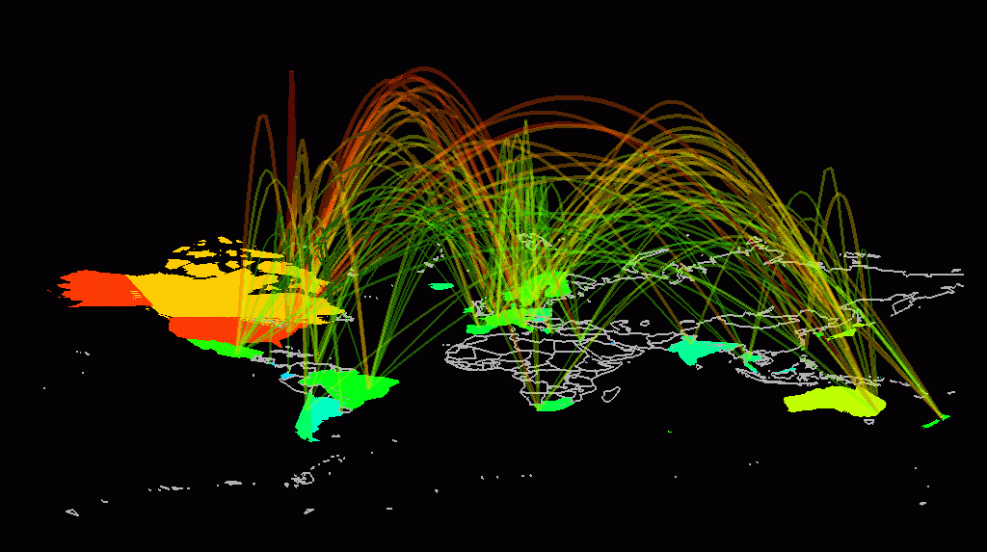
Connectivism
Learners access multiple databases and sources of knowledge
Notes:
Downes and Siemens
Connection to and creation of networks
Assist learners to connect to networks of scholars, activists, etc.
Assist learners to contribute to networks by publishing own work
Assist learners to create networks based on personal interests

Slide 16
Connectivism
Learners access multiple databases and sources of knowledge
Learners MUST share their projects and products
Notes:
Downes and Siemens
Connection to and creation of networks
Assist learners to connect to networks of scholars, activists, etc.
Assist learners to contribute to networks by publishing own work
Assist learners to create networks based on personal interests

Slide 17
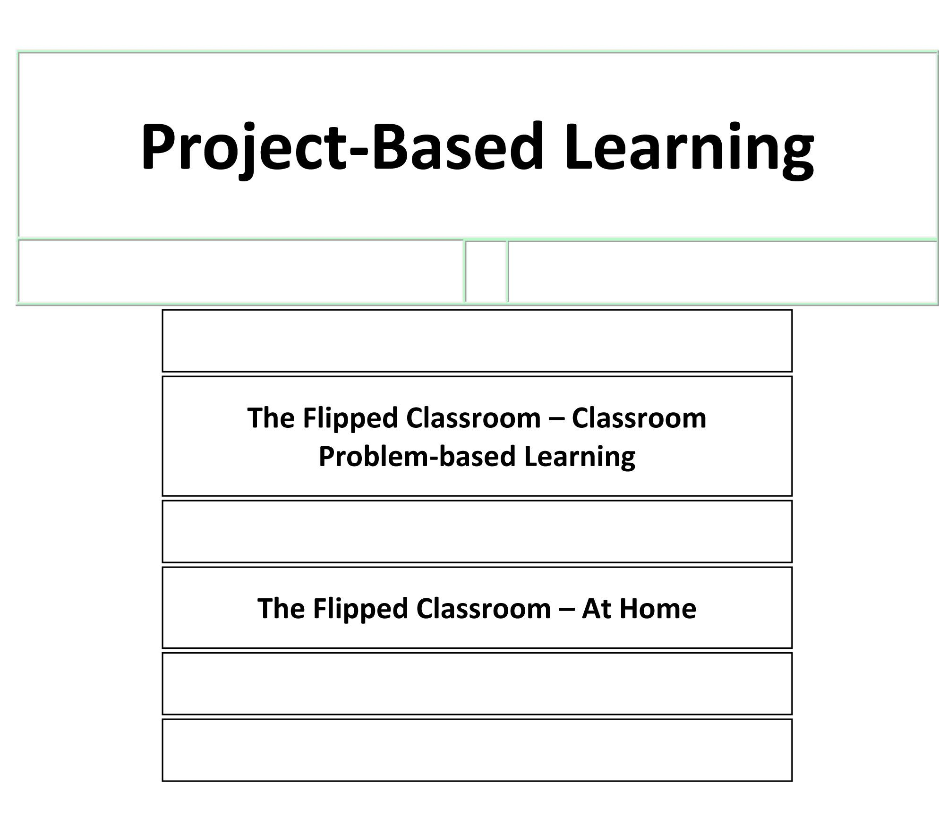
Notes:
Small groups - HOW can you bring these to your classroom?
What are your obstacles?
How can you overcome those obstacles?
What are the BENEFITS?
WHAT IS STOPPING YOU?
Think of a way to integrate it into your class:
Start with an end product (wouldn’t it be cool if?)
What knowledge should students END the project with?
How are they going to obtain that knowledge?
How are you going to SUPPLEMENT that knowledge?

Slide 18
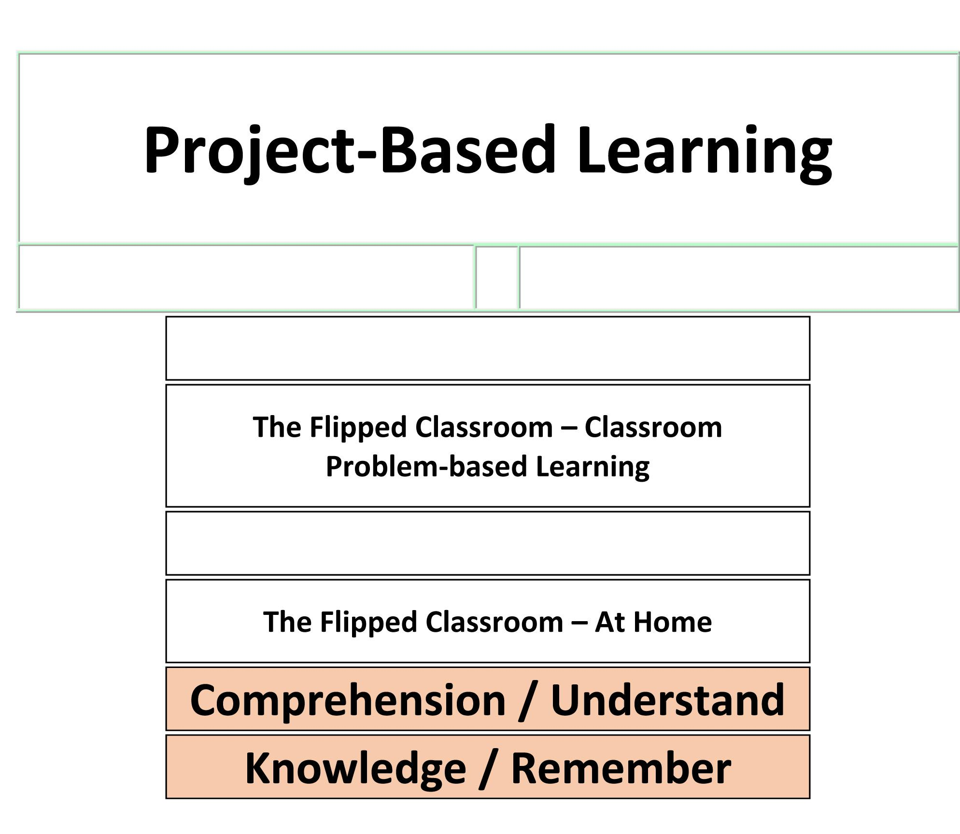
Notes:
Small groups - HOW can you bring these to your classroom?
What are your obstacles?
How can you overcome those obstacles?
What are the BENEFITS?
WHAT IS STOPPING YOU?
Think of a way to integrate it into your class:
Start with an end product (wouldn’t it be cool if?)
What knowledge should students END the project with?
How are they going to obtain that knowledge?
How are you going to SUPPLEMENT that knowledge?

Slide 19
Notes:
Small groups - HOW can you bring these to your classroom?
What are your obstacles?
How can you overcome those obstacles?
What are the BENEFITS?
WHAT IS STOPPING YOU?
Think of a way to integrate it into your class:
Start with an end product (wouldn’t it be cool if?)
What knowledge should students END the project with?
How are they going to obtain that knowledge?
How are you going to SUPPLEMENT that knowledge?

Slide 20
Notes:
Small groups - HOW can you bring these to your classroom?
What are your obstacles?
How can you overcome those obstacles?
What are the BENEFITS?
WHAT IS STOPPING YOU?
Think of a way to integrate it into your class:
Start with an end product (wouldn’t it be cool if?)
What knowledge should students END the project with?
How are they going to obtain that knowledge?
How are you going to SUPPLEMENT that knowledge?

