Slide 1
Flipped Classroom
& PBL:
Theory and Practice
Bill Huitt
@whuitt
Katie Vernon
@KVernonBHS
Back Channel:
https://todaysmeet.com/FlippedPBLWorkshop

Slide 2
Part 4 Introduction to PBL

Slide 3
Project/Problem Based Learning (PBL)
Project vs Problem:
Project = “maker” movement, create something new/different
Problem = use case studies, solve problems
Notes:
Application, evaluation, synthesis of concepts
Student voice and choice
Students set goals and learn how to break down big projects
Allows for and encourages interdisciplinary studies

Slide 4
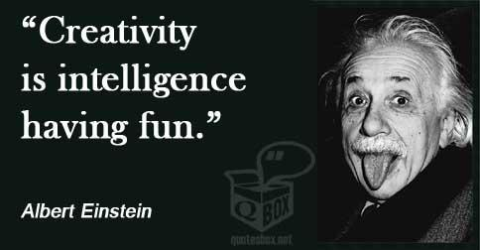
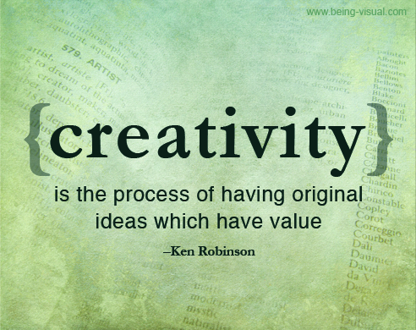
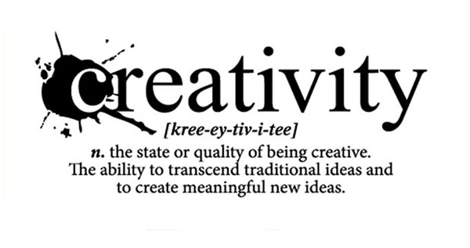

Slide 5
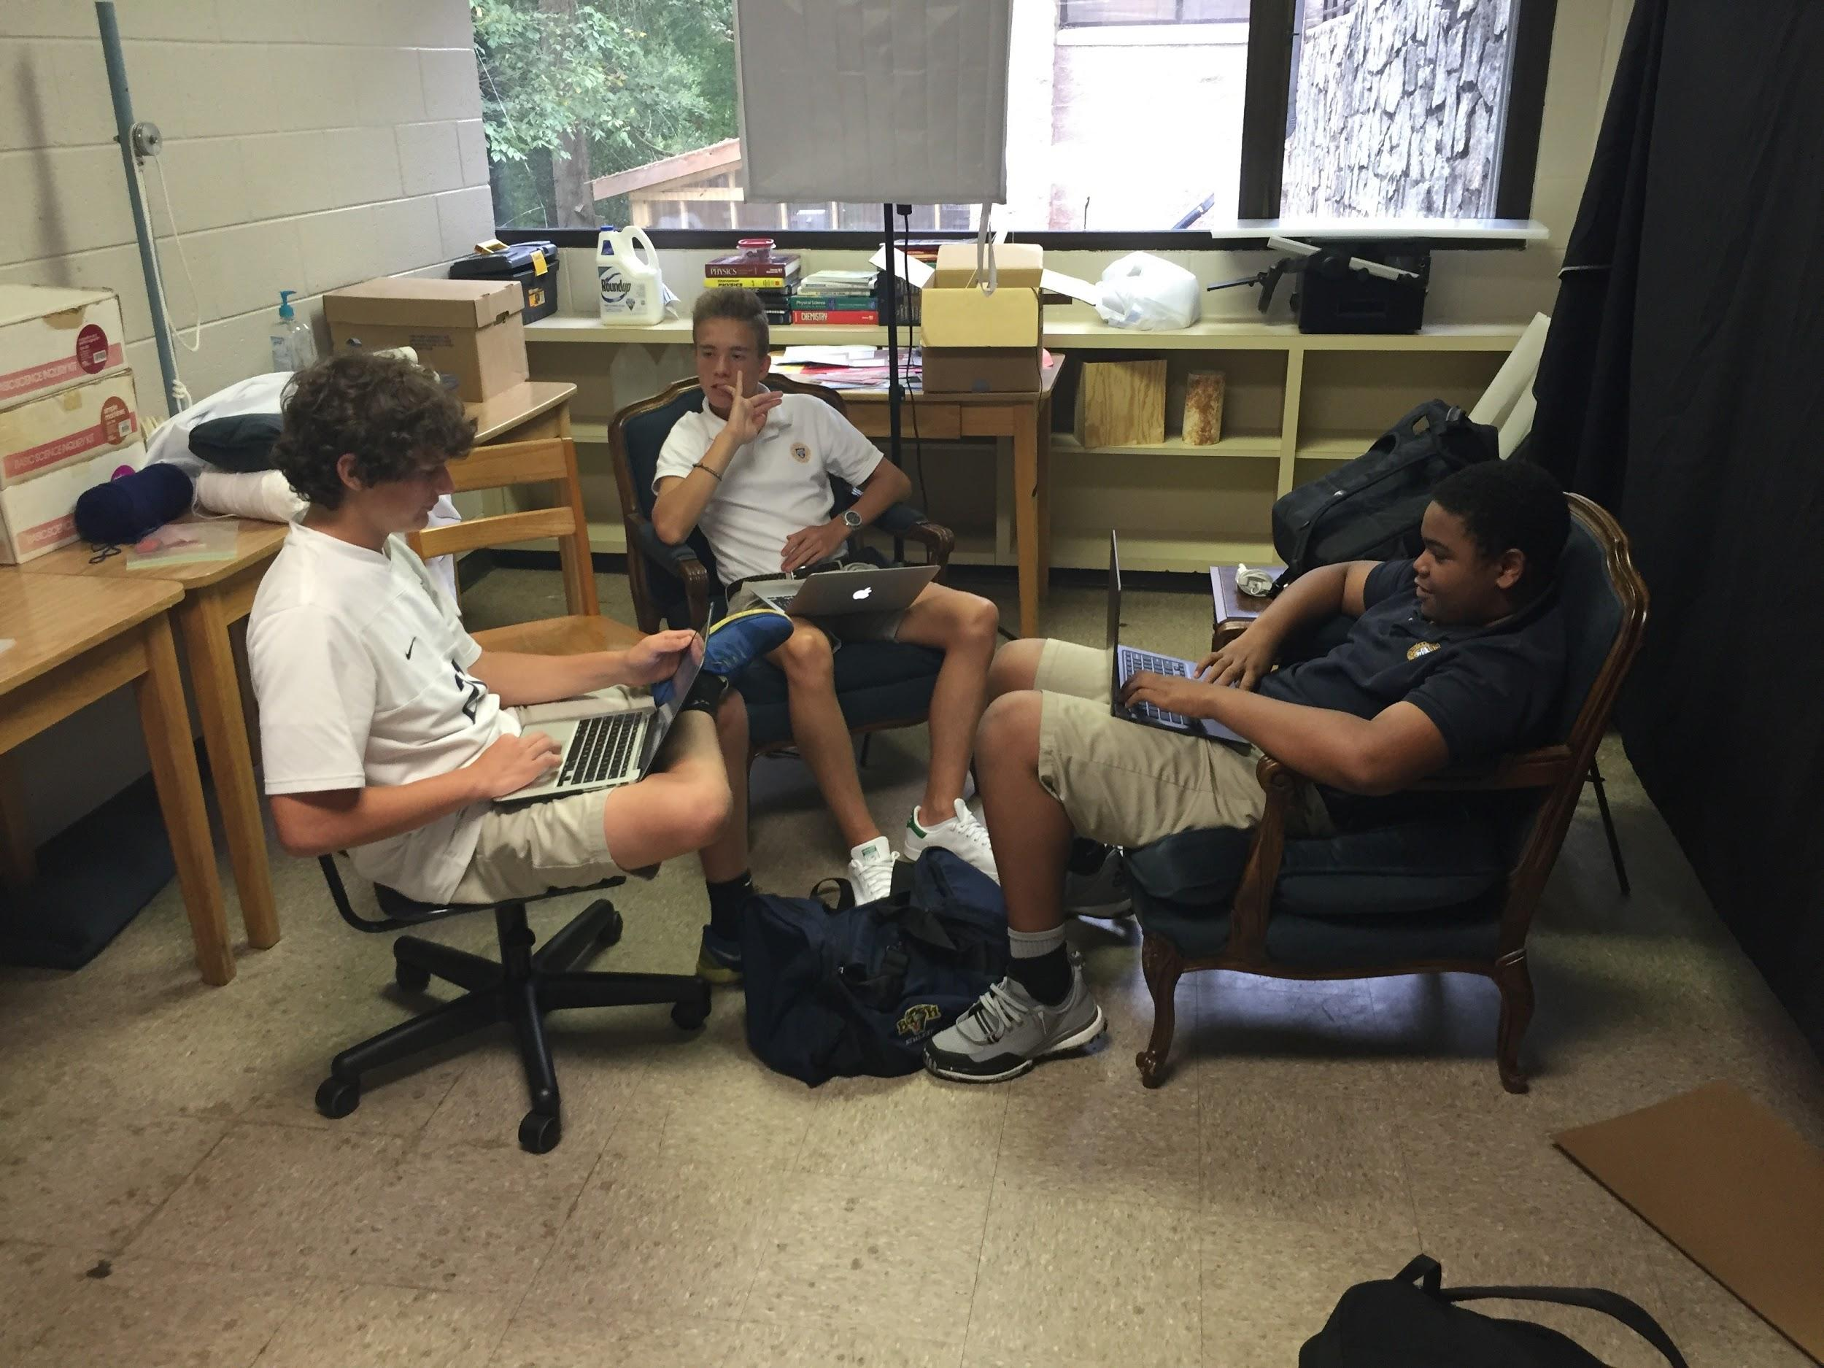
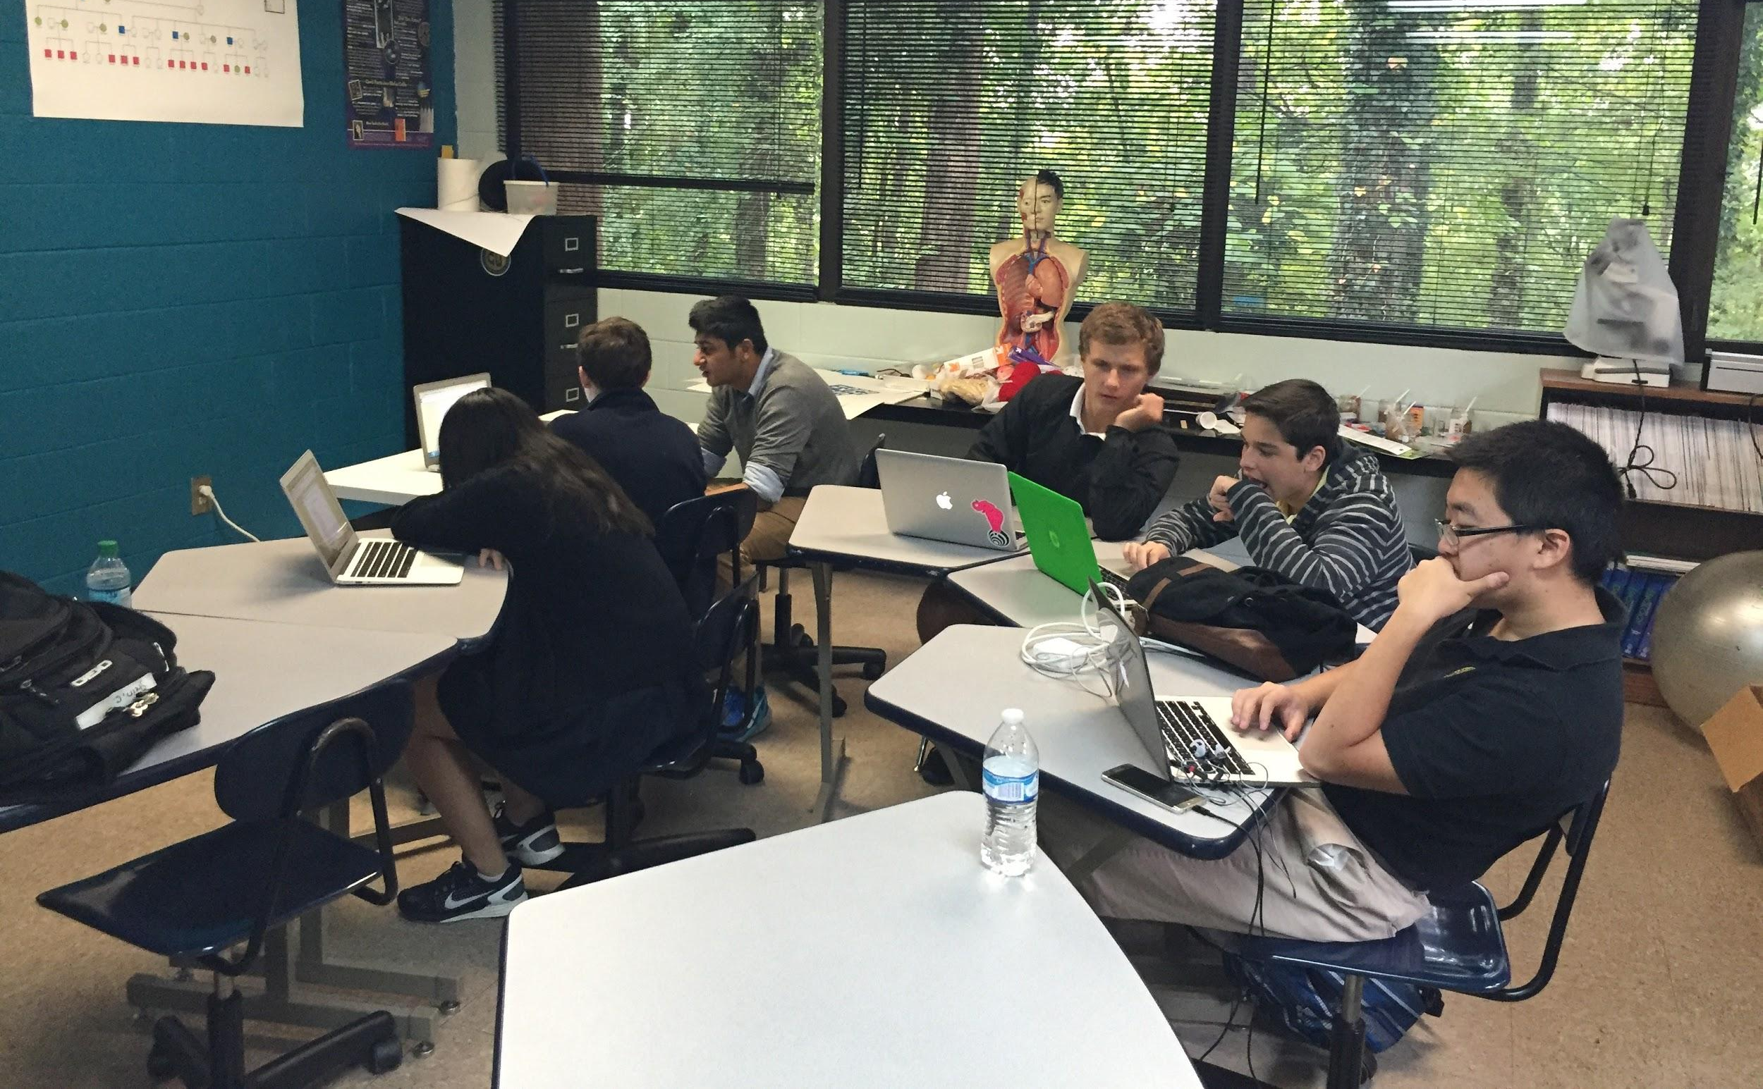
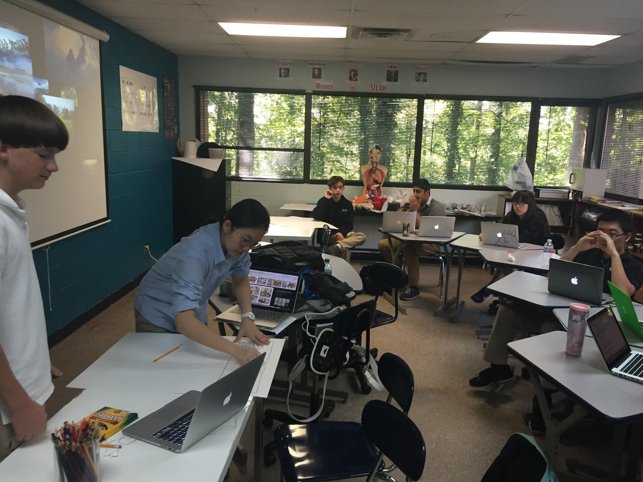
My PBL Classroom
Notes:
Day in the life video
Student testimonials
Photos
IN class short term projects vs long term

Slide 6
How Do You USE PBL?
Short Term (in class) Projects:
2-4 days in class
Teacher driven
Problem solving, critical thinking
Collaboration, teamwork
Expert (YOU) for guidance
Research, write, create, design
Notes:
What does it look like?
Different in every classroom/for every project
Students engaged
Collaboration/teamwork
Lively discussions

Slide 7
How Do You USE PBL?
Short Term (in class) Projects:
2-4 days in class
Teacher driven
Problem solving, critical thinking
Collaboration, teamwork
Expert (YOU) for guidance
Research, write, create, design
Long Term (in class) Projects:
Semester or year long
Student driven
Problem solving, critical thinking
Collaborate or individual
Expert (maybe you, maybe not you) for guidance
Research → PLAN → design → create → innovate
Notes:
What does it look like?
Different in every classroom/for every project
Students engaged
Collaboration/teamwork
Lively discussions

Slide 8
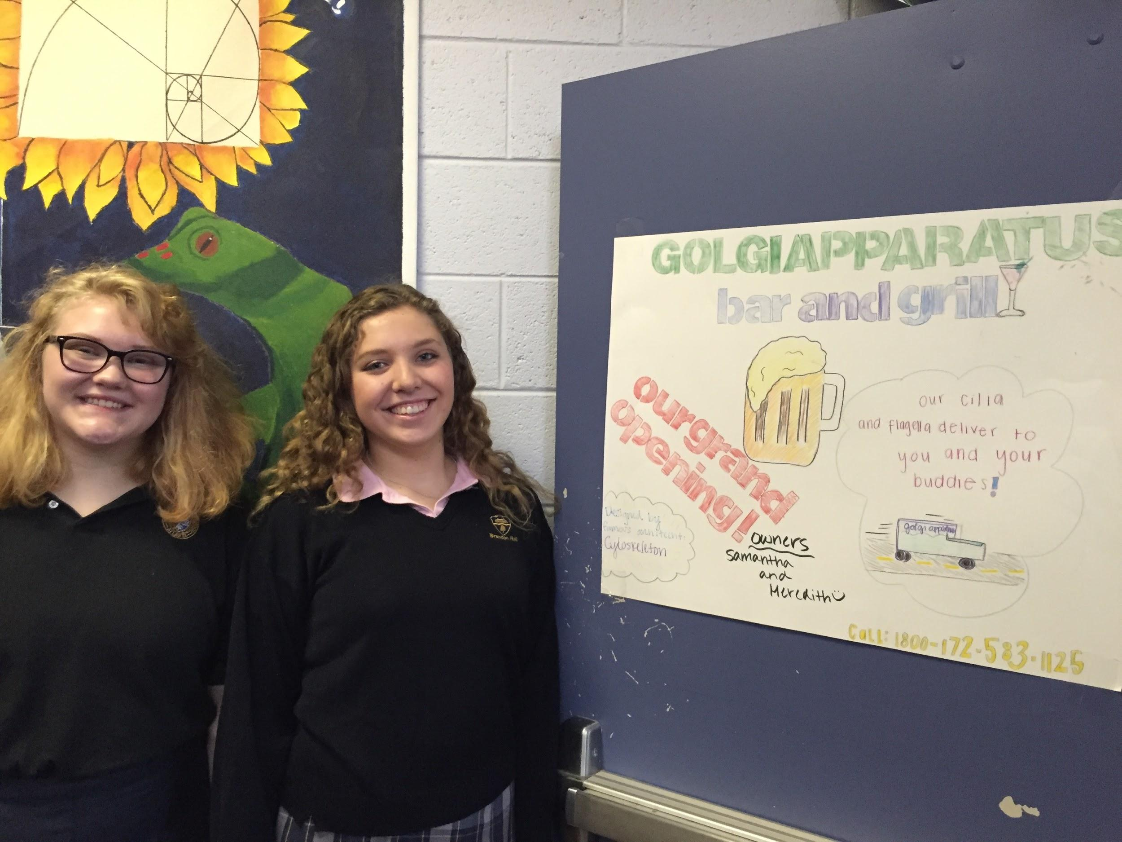
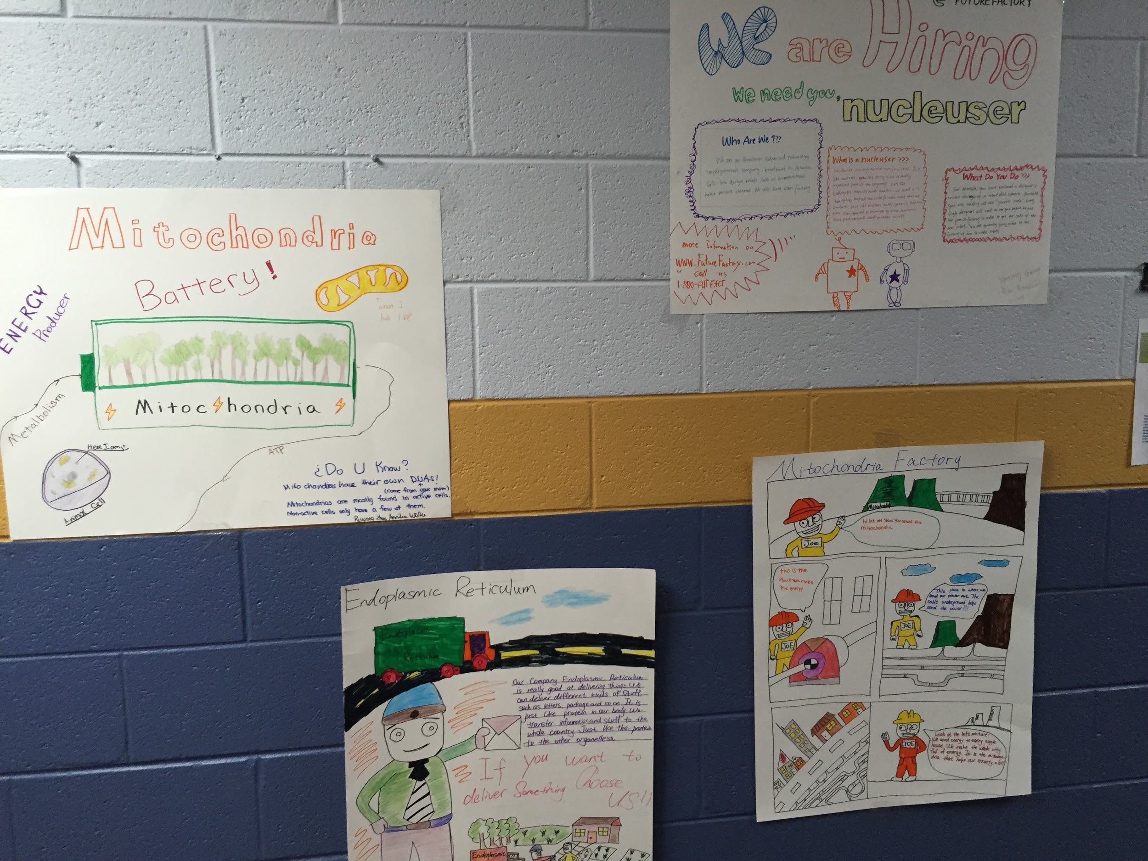
Examples From My Classroom
Short Term:
Movies
Posters
Songs
Games
Poems
Presentations
Short Stories

Slide 9
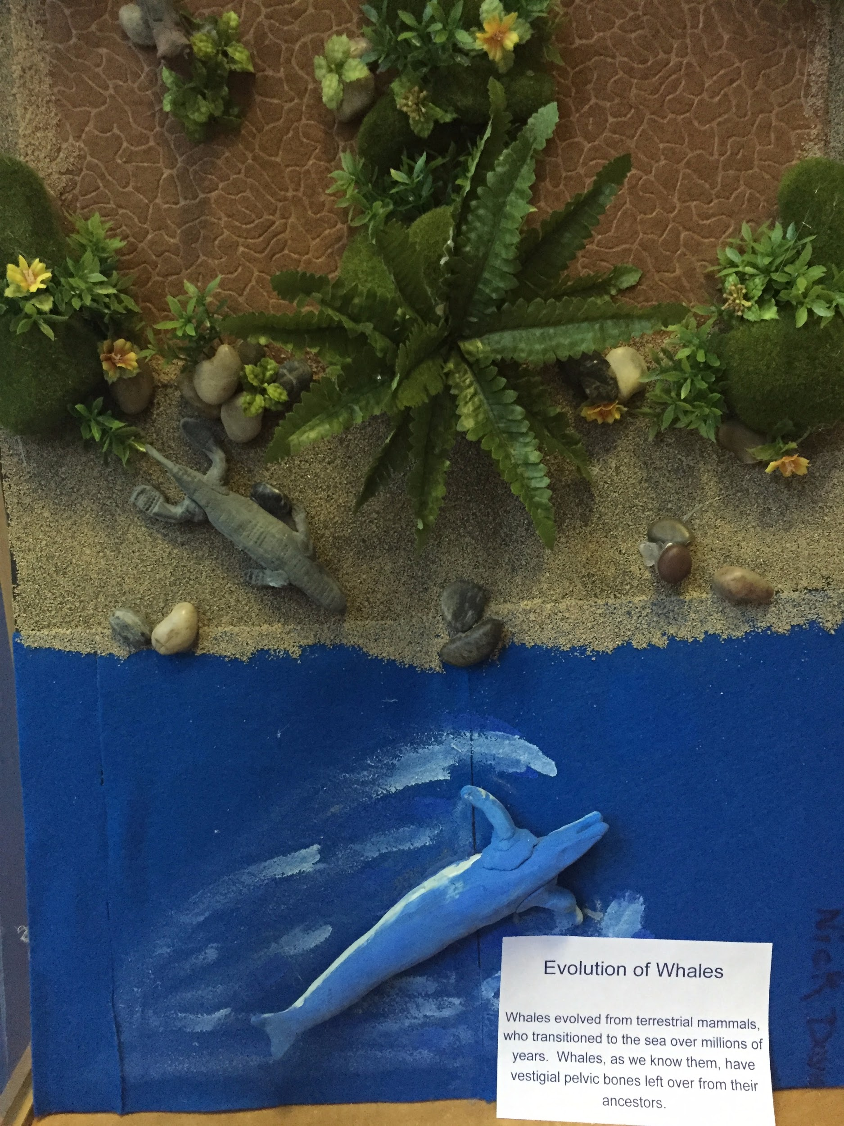
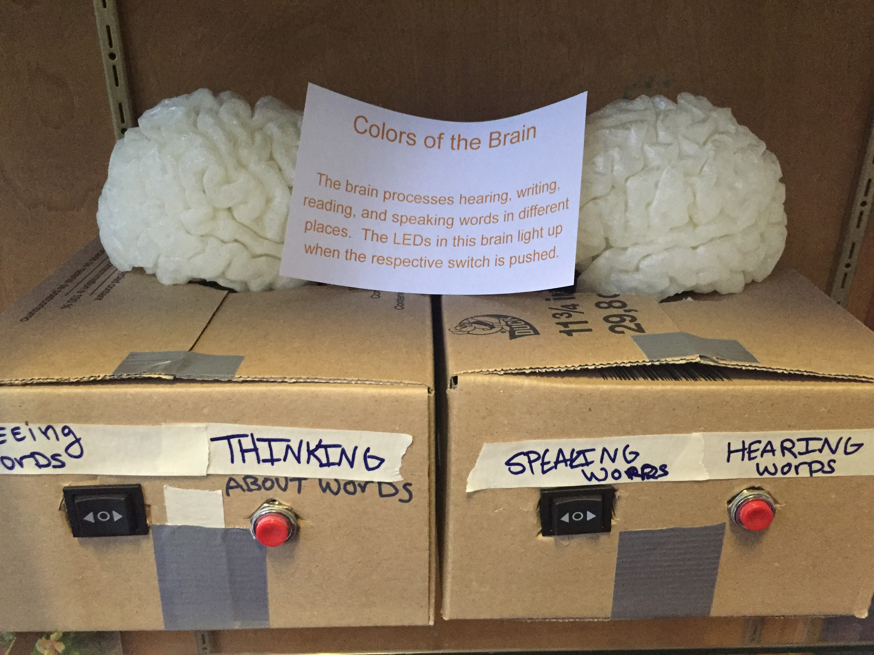
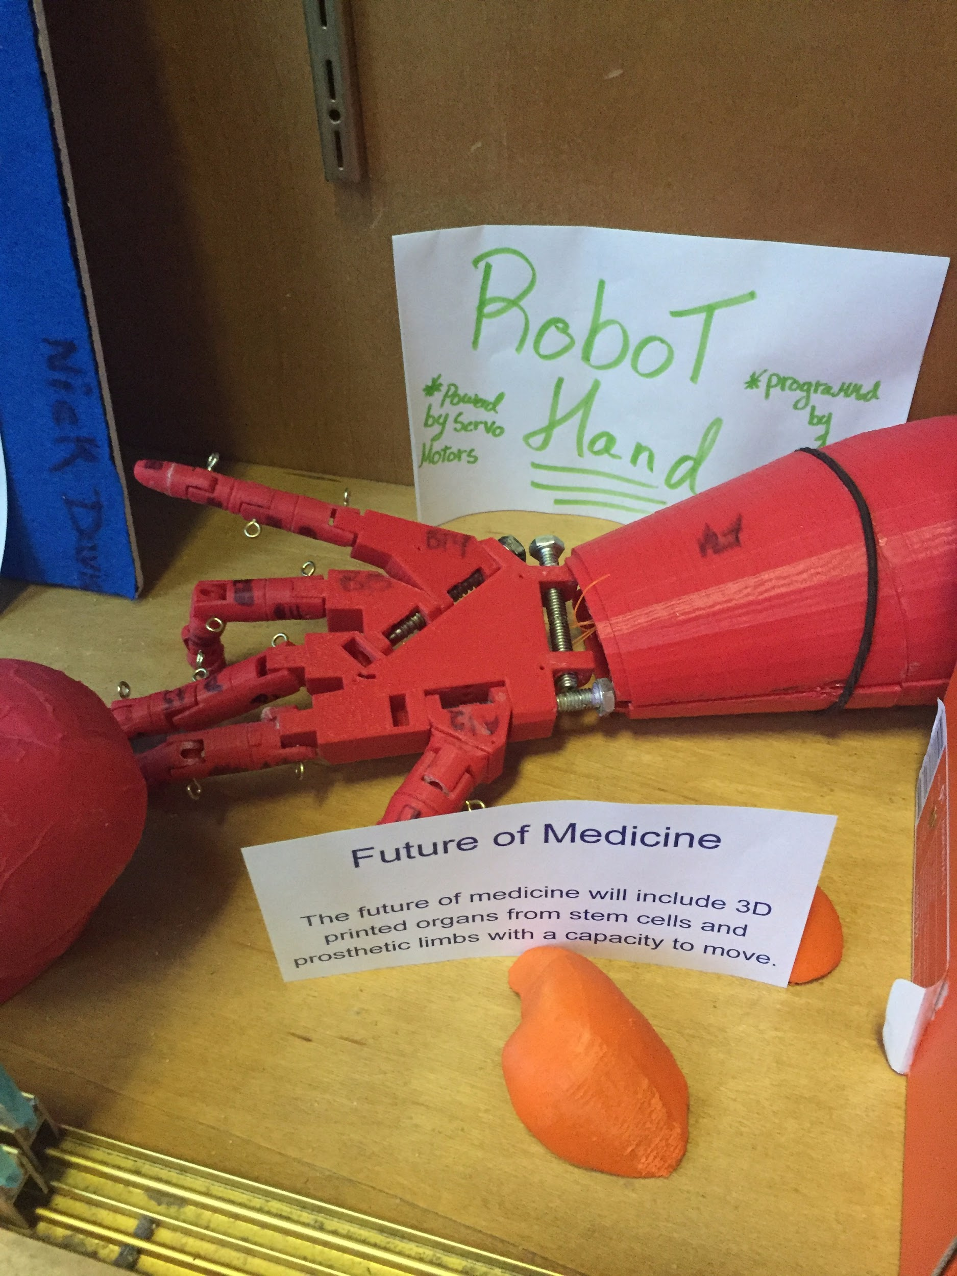
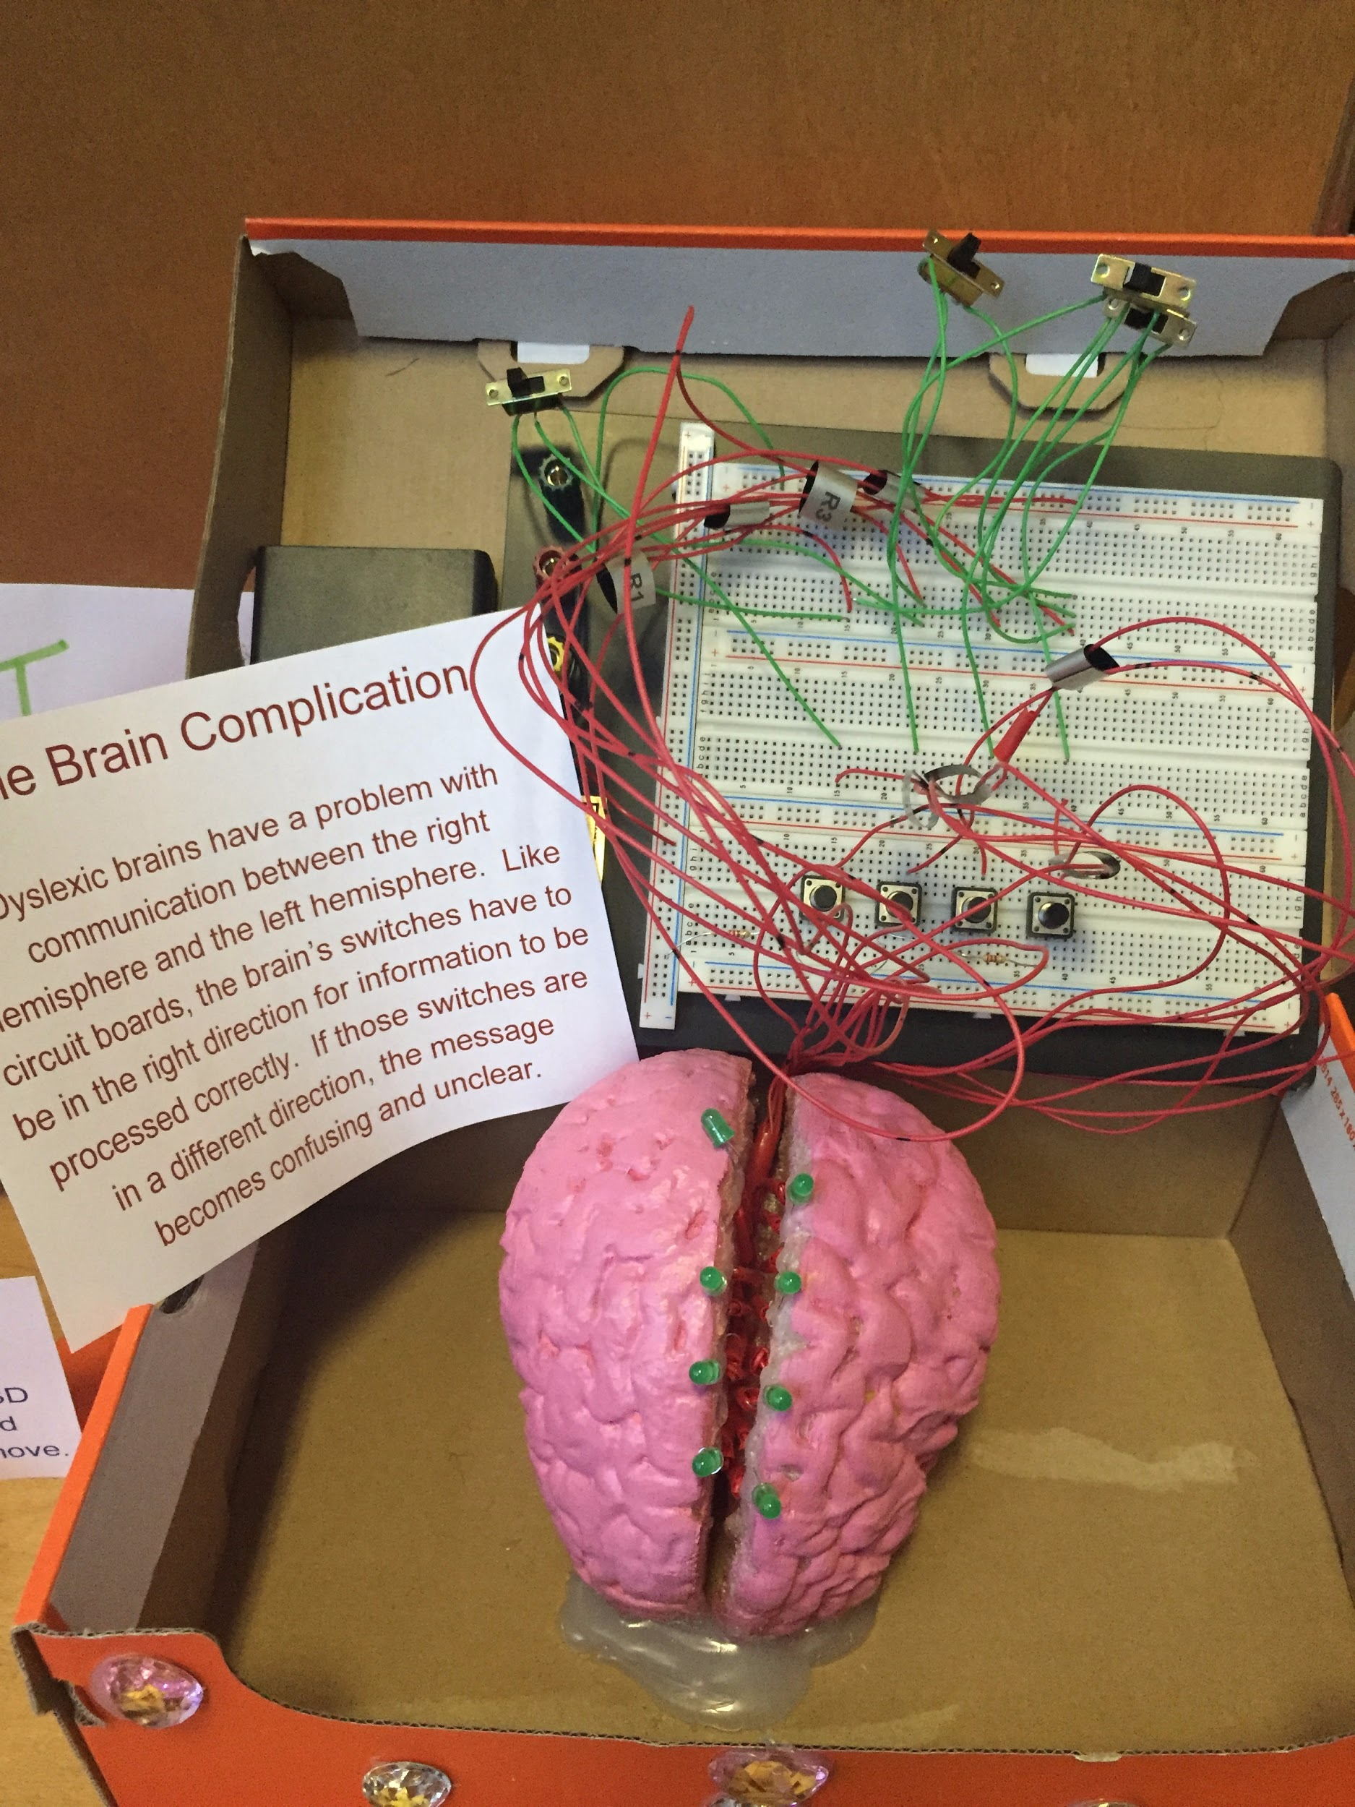
Examples From My Classroom
Short Term:
Long Term:
Movies
Posters
Songs
Games
Poems
Presentations
Short Stories

Slide 10
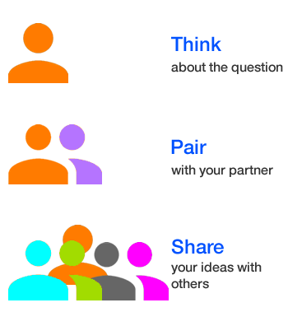
What are some of the BENEFITS of integrating PBL into your classroom?
What are some of the CHALLENGES of integrating PBL into your classroom?
Notes:
Hands on learning
Active engagement
Innovation, creativity
Teamwork and collaboration

Slide 11
Benefits and Challenges

Slide 12
Project Based Learning
HOW?
Create time

Slide 13
Project Based Learning
HOW?
Create time
Flip your content

Slide 14
Project Based Learning
HOW?
Create time
Flip your content
Start at the end
RUBRICS, detailed instructions

Slide 15
Project Based Learning
HOW?
Create time
Flip your content
Start at the end
RUBRICS, detailed instructions
ASK YOUR STUDENTS!

Slide 16
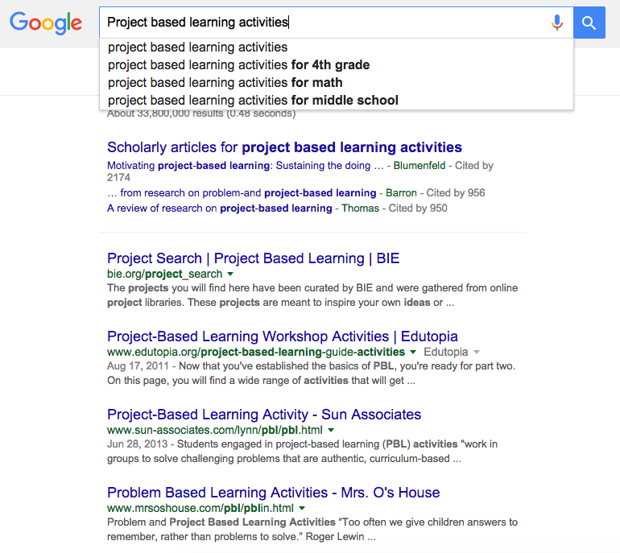
Project Based Learning
HOW?
Create time
Flip your content
Start at the end
RUBRICS, detailed instructions
ASK YOUR STUDENTS!
Use the INTERNET

