Slide 1
Flipped Classroom
& PBL:
Theory and Practice
Bill Huitt
@whuitt
Katie Vernon
@KVernonBHS
Back Channel:
https://todaysmeet.com/FlippedPBLWorkshop

Slide 2
Part 2 Introduction to Flipped Learning

Slide 3
What Does a “Traditional” Classroom Look Like?
Teacher Centered Learning
Notes:
Lecture in class, send HW home
Practice happens outside of classroom
Students do not have access to experts when they practice
No time for application, hands on activities, labs, etc

Slide 4
What Does a “Traditional” Classroom Look Like?
Teacher Centered Learning
Content Delivery
IN CLASS
Notes:
Lecture in class, send HW home
Practice happens outside of classroom
Students do not have access to experts when they practice
No time for application, hands on activities, labs, etc

Slide 5
What Does a “Traditional” Classroom Look Like?
Expert Work at Home
Teacher Centered Learning
Content Delivery
IN CLASS
Notes:
Lecture in class, send HW home
Practice happens outside of classroom
Students do not have access to experts when they practice
No time for application, hands on activities, labs, etc

Slide 6
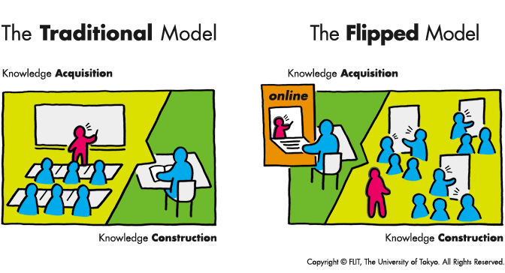
How is Flipped Learning Different?
Notes:
Flipping does not ALWAYS have to involve video
Important thing to remember: CONTENT delivered at home, application occurs IN CLASS with the expert
How is “flipped learning” different?
“Lecture” is done at home
Students come to class with prior knowledge
Students gain confidence
“Expert” is around for practice and application of concepts

Slide 7
My Flipped Classroom
Homework: a 7-12 minute video lecture or reading/researching assignment

Slide 8
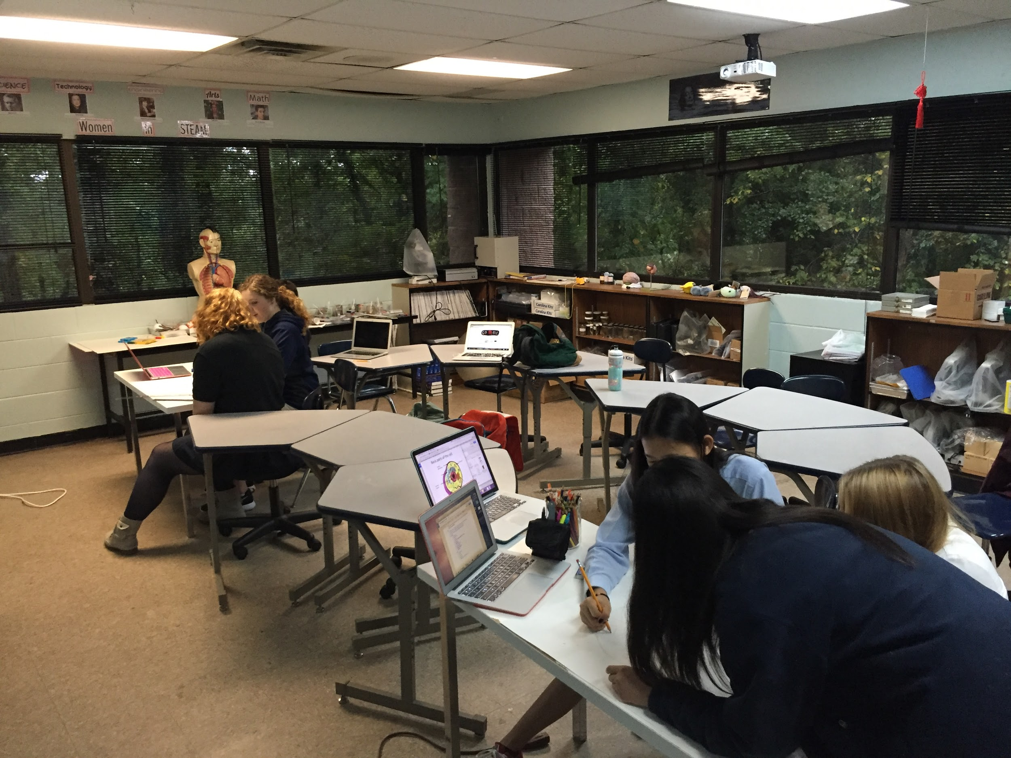
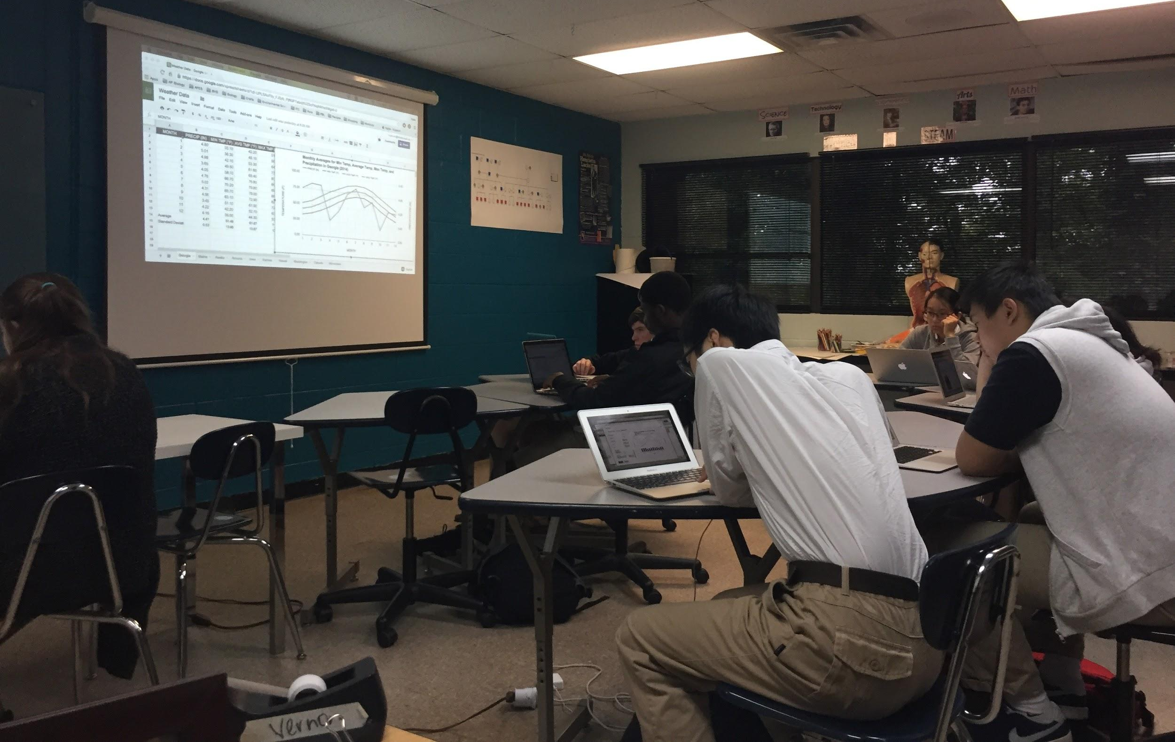
My Flipped Classroom
Homework: a 7-12 minute video lecture or reading/researching assignment
Classtime: every day is different; students are engaged in class activities, group work, problem solving, application of knowledge

Slide 9
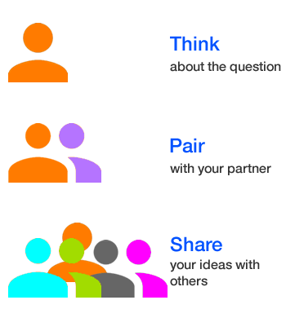
What are some of the BENEFITS of flipping your classroom?
What are some of the CHALLENGES of flipping your classroom?
Notes:
PRIOR KNOWLEDGE
More time in class
More application, problem solving, critical thinkin

Slide 10
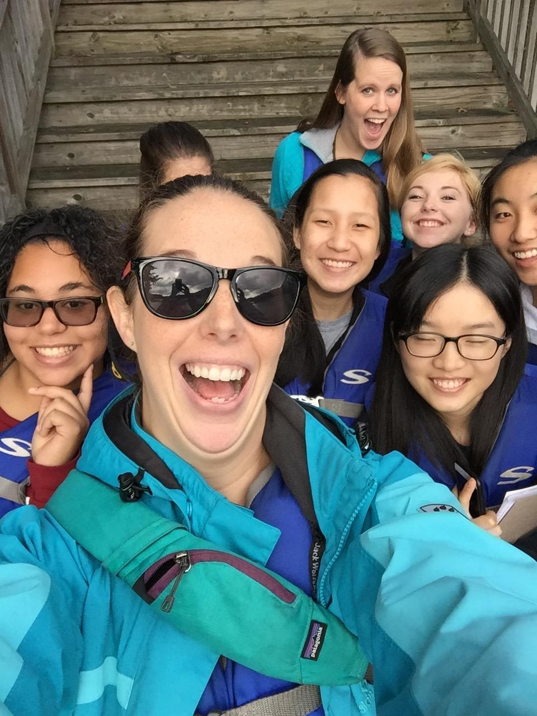
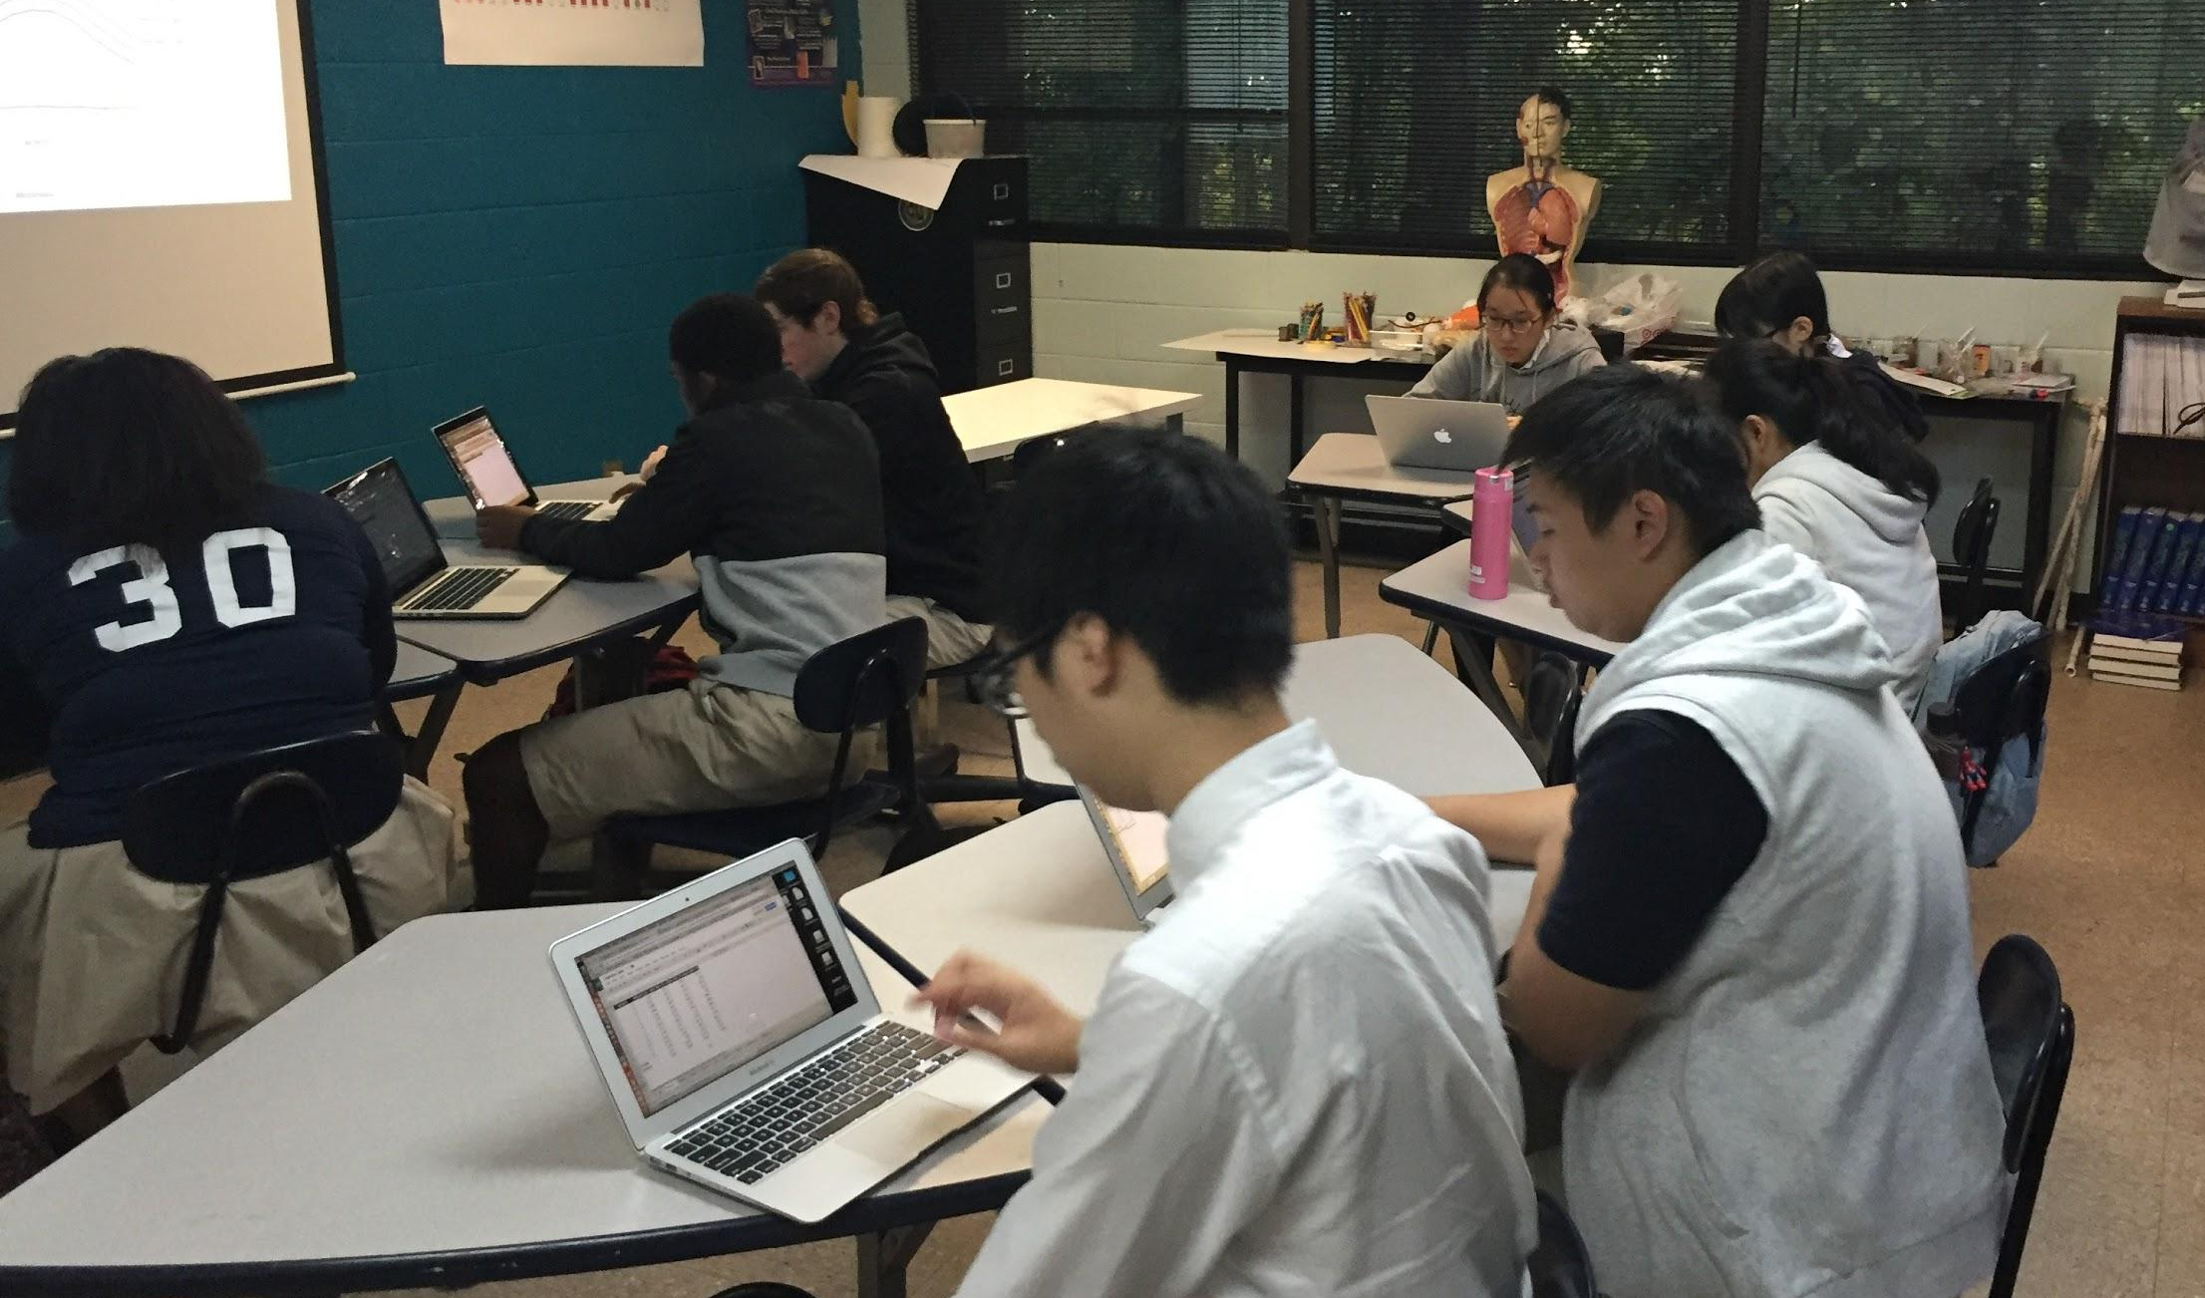
MY Flipped Classroom
Benefits:
100% homework completion
Better note taking skills
Figure out what students DON’T know
More time to DO in class
More application, evaluation, synthesis, and creation (Bloom’s Taxonomy)

Slide 11
MY Flipped Classroom
Challenges:
Learning how to make videos
Figuring out what’s important
Setting aside time to learn
TEACHING students how to watch videos and take notes
Setting reasonable expectations for students
Benefits:
100% homework completion
Better note taking skills
Figure out what students DON’T know
More time to DO in class
More application, evaluation, synthesis, and creation (Bloom’s Taxonomy)

